Slide 1

CLOUD
NATIVE
ARTIFICIAL INTELLIGENCE

Slide 2
Introduction:
The Convergence of Cloud Native and AI
In today's technology landscape, two significant trends stand out for their transformative impacts on industries across the board:
Cloud Native (CN) and
Artificial Intelligence (AI).

Slide 3
Introduction:
The Convergence of Cloud Native and AI
Cloud Native technologies, which include
Containers,
Microservices, and
Kubernetes,
These are designed to leverage the full benefits of cloud computing.
These technologies provide scalable, flexible, and highly resilient system architectures.

Slide 4
Introduction:
The Convergence of Cloud Native and AI
When combined with the power of AI, they enable organizations to create sophisticated, adaptive, and efficient applications.
Kubernetes, the de facto standard for orchestrating containerized applications, plays a pivotal role in managing AI workloads.
It simplifies deployment, scaling, and management, making it easier for organizations to implement complex AI-driven solutions.

Slide 5
The Evolution of AI and
its Deep Integration with CN
Artificial Intelligence has evolved dramatically since its inception, with pivotal developments from basic machine learning models to advanced deep learning and neural networks.
This evolution has been significantly supported by Cloud Native infrastructures, which facilitate the training and deployment of these complex models at scale.

Slide 6
The Evolution of AI and
its Deep Integration with CN
Key technologies such as
Transformers and
Convolutional Neural Networks (CNNs)
have revolutionized tasks like natural language processing and image recognition.
These technologies rely heavily on the scalability and robustness provided by Cloud Native environments, particularly for handling large datasets and intensive computational processes.

Slide 7
Navigating Challenges and
Seizing Opportunities
While the integration of CN and
AI offers numerous benefits, it also presents unique challenges.
Data management,
privacy, security, and
computational demands
are among the primary concerns that developers and IT professionals face in this integrated approach.

Slide 8
Navigating Challenges and
Seizing Opportunities
For instance, ensuring the security of sensitive data used in AI models and managing the high computational demands of training these models are critical issues that need robust solutions.

Slide 9
Navigating Challenges and
Seizing Opportunities
However, these challenges also open doors to innovative solutions.
The development of new tools for
automated model tuning,
resource optimization, and
enhanced security protocols
are just a few areas where inventive solutions are rapidly emerging.
Additionally, the rise of cross-cutting concerns like sustainability in computing requires new strategies to manage the environmental impact of large-scale AI operations.

Slide 10
The Road Ahead:
Strategies and Solutions for Cloud Native AI
Looking forward, the integration
of CN and AI technologies will only deepen, necessitating strategic approaches and robust solutions.
Embracing flexible architectural frameworks, advocating for sustainability, and ensuring seamless integration across various platform dependencies are crucial.

Slide 11
The Road Ahead:
Strategies and Solutions for Cloud Native AI
Tools like Kubeflow have emerged as leaders in orchestrating AI workflows, demonstrating the practical application of CN principles in managing AI operations.
Moreover, advancements in observability tools like OpenLLMetry illustrate the importance of monitoring and maintaining AI systems efficiently in production environments.

Slide 12
Conclusion:
Harnessing the Potential of
Cloud Native AI
The synergy between Cloud Native and AI is setting the stage for a new era of technology development.
Organizations that effectively leverage this combination will enjoy significant competitive advantages, including the ability to automate complex processes, analyze vast datasets, and offer personalized user experiences.

Slide 13
Conclusion:
Harnessing the Potential of
Cloud Native AI
As we look to the future, the continued evolution of these technologies promises even greater integration and innovation.
By investing in the right tools, talent, and strategies, businesses can unlock the full potential of Cloud Native AI, leading to more innovative, resilient, and efficient technological solutions.

Slide 14
INTRODUCTION TO CLOUD NATIVE
ARTIFICIAL INTELLIGENCE (CNAI)
The Cloud Native Computing Foundation defines9 Cloud Native as: Cloud Native technologies empower organizations to build and run scalable applications in modern, dynamic environments such as public, private, and hybrid clouds. Containers, service meshes, microservices, immutable infrastructure, and declarative APIs exemplify this approach. These techniques enable loosely coupled systems that are resilient, manageable, and observable. Combined with robust automation, they allow engineers to make high-impact changes frequently and predictably with minimal toil. The Cloud Native Computing Foundation seeks to drive the adoption of this paradigm by fostering and sustaining an ecosystem of open source, vendor-neutral projects. We democratize state-of-the-art patterns to make these innovations accessible to everyone.

Slide 15
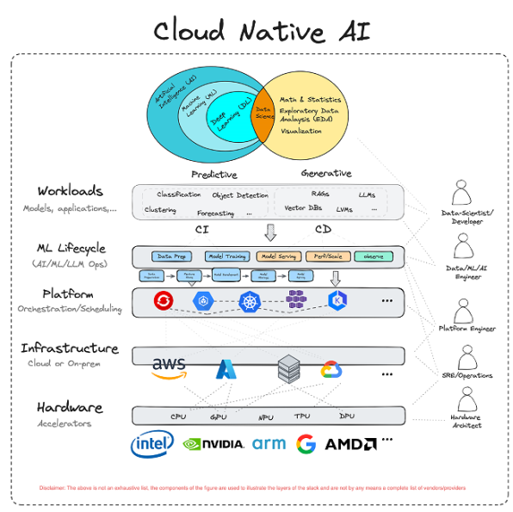

Slide 16
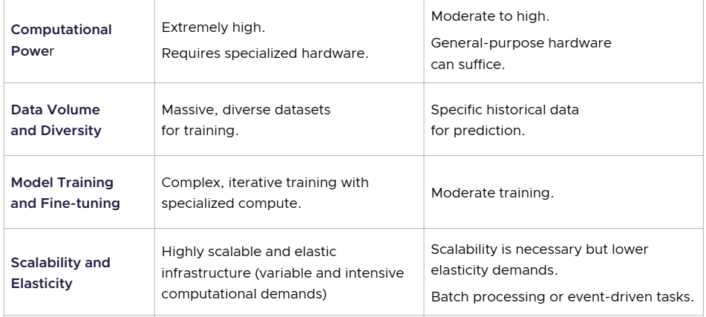
INTRODUCTION TO CLOUD NATIVE
ARTIFICIAL INTELLIGENCE (CNAI)
Merging of Cloud Native and Artificial Intelligence
Below is a sample set of areas where predictive and generative AI have distinct needs across computing, networking, and storage:

Slide 17
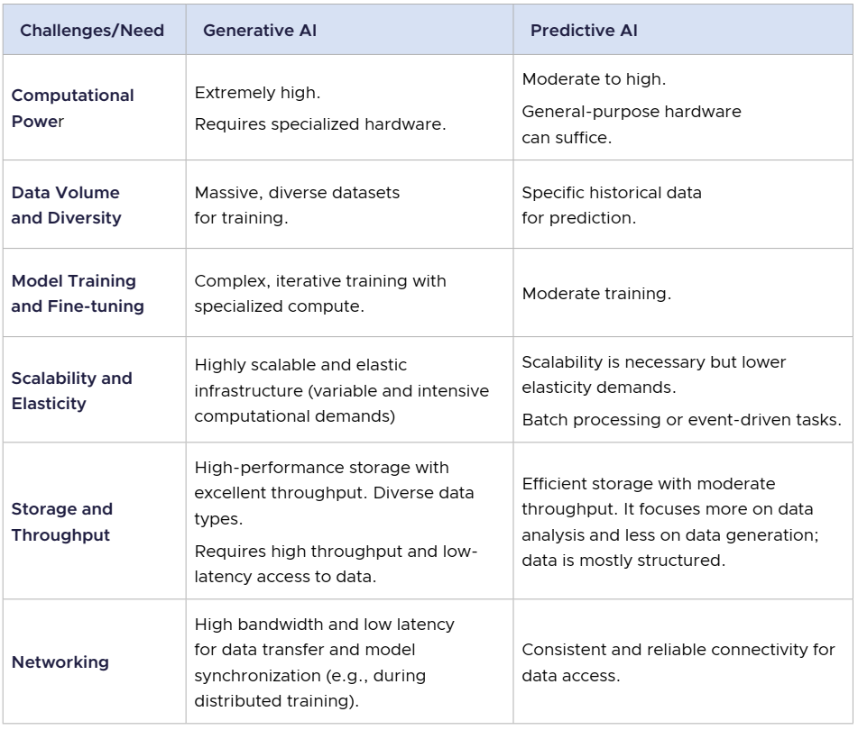

Slide 18
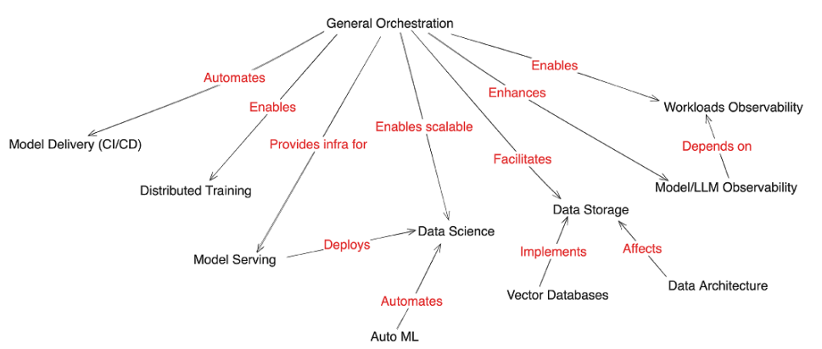

INTRODUCTION TO CLOUD NATIVE
ARTIFICIAL INTELLIGENCE (CNAI)
What is Cloud Native Artificial Intelligence?
Figure 2 (below) maps these enabling mechanisms between tooling and techniques.

Slide 19
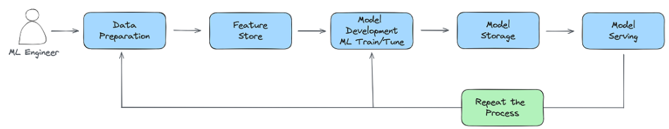

CHALLENGES FOR CLOUD NATIVE ARTIFICIAL INTELLIGENCE
It’s important to note that CNAI challenges will vary between the different personas.26 And, while Cloud Native’s flexible, scalable platform is a promising fit for AI workloads, AI’s scale and latency needs pose challenges and expose gaps in CN technologies while also presenting opportunities. We tease these out in the context of an end-to-end ML pipeline.27 also referred to in the literature as MLOps.28 Issues with the traditional trade-offs of time and space, parallelism, and synchronization all surface, exposing ease-ofuse gaps. To summarize, the ML Lifecycle looks as follows:

Slide 20
CHALLENGES FOR CLOUD NATIVE ARTIFICIAL INTELLIGENCE
The typical ML pipeline is comprised of: • Data Preparation (collection, cleaning/pre-processing, feature engineering) • Model Training (model selection, architecture, hyperparameter tuning) • CI/CD, Model Registry (storage) • Model Serving • Observability (usage load, model drift, security)

Slide 21
THANK YOU!
CLOUD NATIVE
COMPUTING FOUNDATION

